Slide 1
Lecture 15

Slide 2
Security of Public Key Schemes
like private key schemes brute force exhaustive search attack is always theoretically possible
but keys used are too large (>512bits)
security relies on a large enough difference in difficulty between easy (en/decrypt) and hard (cryptanalyze) problems
more generally the hard problem is known, it’s just made too hard to do in practice
requires the use of very large numbers
hence is slow compared to private/symmetric key schemes

Slide 3
Public-Key Cryptography Algorithm
(RSA)

Slide 4
RSA Public-key encryption
by Rivest, Shamir & Adleman of MIT in 1977
currently the “work horse” of Internet security
most public key infrastructure (PKI) products
SSL/TLS: certificates and key-exchange
secure e-mail: PGP, Outlook, ….
based on exponentiation in a finite (Galois) field over integers modulo a prime
exponentiation takes O((log n)³) operations (easy)
security due to cost of factoring large numbers
factorization takes O(e ^{log n log log n}) operations (hard)
uses large integers (eg. 1024 bits)

Slide 5
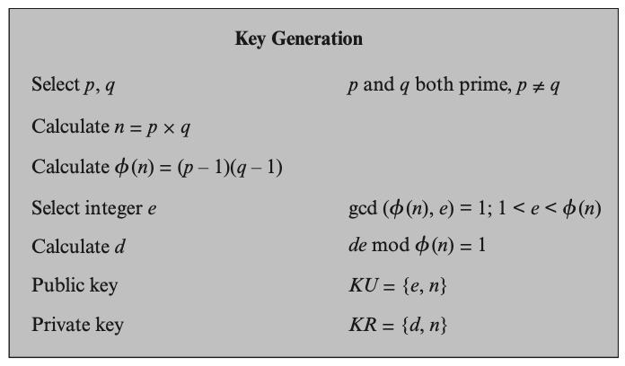
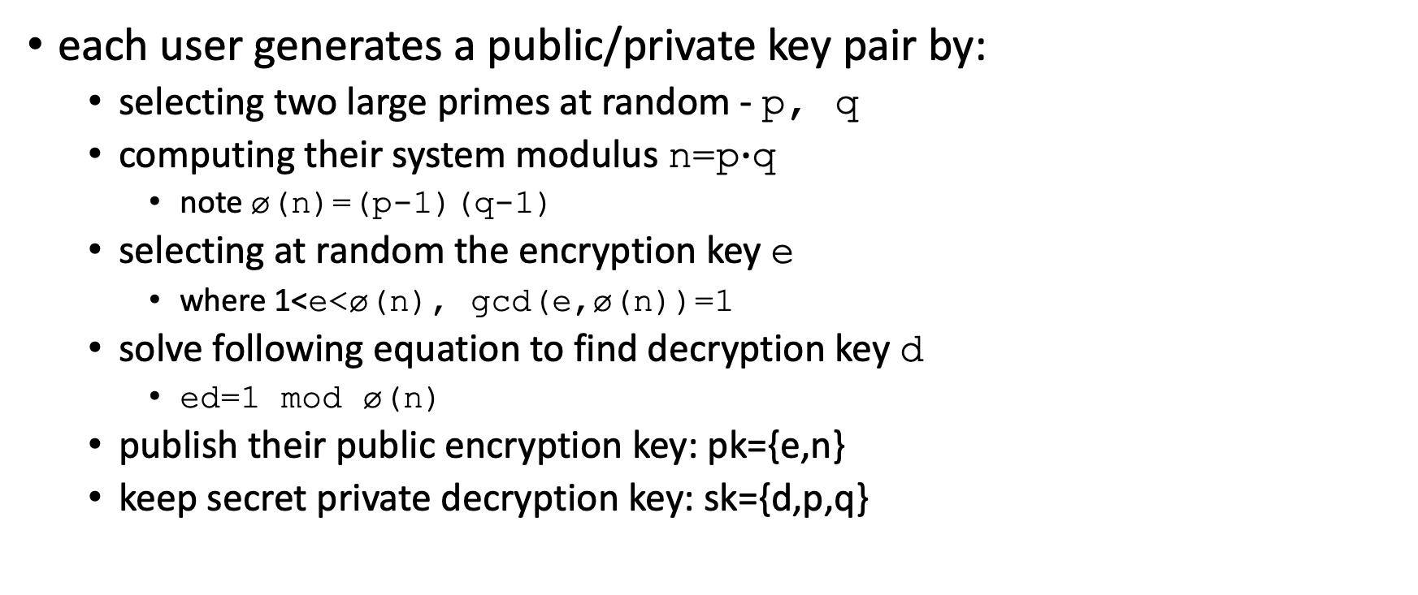
RSA key setup
each user generates a public/private key pair by:
selecting two large primes at random - p, q
computing their system modulus n=p$∙$q
note ø(n)=(p-1)(q-1)
selecting at random the encryption key e
where 1<e<ø(n), gcd(e,ø(n))=1
solve following equation to find decryption key d
ed=1 mod ø(n)
publish their public encryption key: pk={e,n}
keep secret private decryption key: sk={d,p,q}

Slide 6
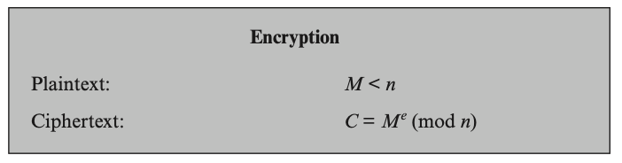
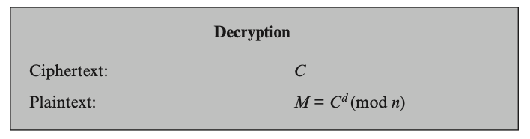
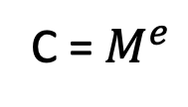
RSA use
to encrypt a message M the sender:
obtains public key of recipient pk={e,n}
computes: C=Me mod n, where 0≤M<n
to decrypt the ciphertext C the owner:
uses their private key sk={d,p,q}
computes: M=C^{d} mod n
note that the message M must be smaller than the modulus n (block if needed)
C = $M^{e}$
Plaintext
Ciphertext
pk={e,n}
sk={d,p,q}

Slide 7
RSA example
Select primes: p=17 & q=11
Compute n = pq =17×11=187
Compute ø(n)=(p–1)(q-1)=16×10=160
Select e : gcd(e,160)=1; choose e=7
Determine d: de=1 mod 160 and d < 160 Value is d=23 since 23×7=161= 10×160+1
Publish public key pk={7,187}
Keep secret private key sk={23,17,11}

Slide 8
RSA example continue
sample RSA encryption/decryption is:
given message M = 88 ( 88<187)
encryption:
C = 88⁷ mod 187 = 11
decryption:
M = 11²³ mod 187 = 88

Slide 9
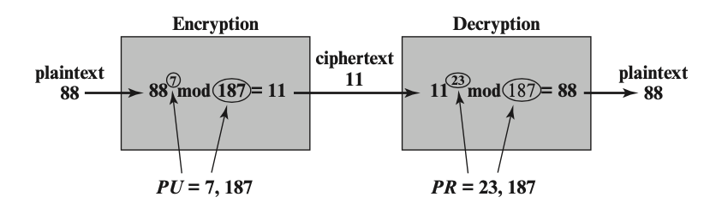
Example of RSA algorithm

Slide 10
RSA key generation
users of RSA must:
determine two primes at random - p, q
select either e or d and compute the other
primes p,q must not be easily derived from modulus n=p.q
means must be sufficiently large
typically guess and use probabilistic test
exponents e, d are inverses, so use Inverse algorithm to compute the other

Slide 11
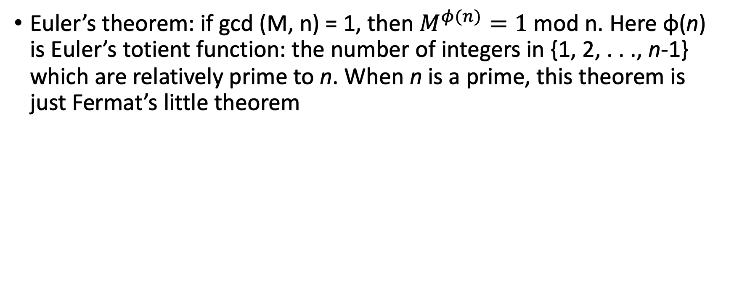
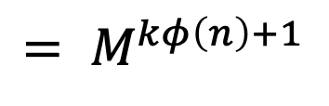

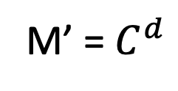
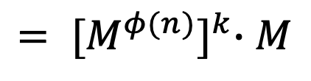
Correctness of RSA
Euler’s theorem: if gcd (M, n) = 1, then $M^{φ(n)}=1$mod n. Here φ(n) is Euler’s totient function: the number of integers in {1, 2, . . ., n-1} which are relatively prime to n. When n is a prime, this theorem is just Fermat’s little theorem
M’ = $C^{d}$
$$=M^{ed }$$
$${= M}^{kφ\left(n\right)+1}$$
$${= [M^{φ(n)}]}^{k}∙M$$
= M

Slide 12
Attack approaches
Mathematical attacks: several approaches, all equivalent in effort to factoring the product of two primes. The defense against mathematical attacks is to use a large key size.
Timing attacks: These depend on the running time of the decryption algorithm
Chosen ciphertext attacks: this type of attacks exploits properties of the RSA algorithm by selecting blocks of data. These attacks can be thwarted by suitable padding of the plaintext, such as PKCS1 V1.5 in SSL

Slide 13
A simple attack on textbook RSA
Client Hello
Web Browser
Web
Server
Server Hello (e, N)
Random session key K
d
C = RSA (K)
Session-key K is 64 bits. View K ∈ {0,…,2⁶⁴}
Eavesdropper sees: C = K^{e} (mod N) .
Suppose K = K₁⋅K₂ where K₁, K₂ < 2³⁴ .
Then: C/K₁e = K₂e (mod N)
Build table: C/1e, C/2e, C/3e, …, C/2^{34e} . time: 2³⁴
For K₂ = 0,…, 2³⁴ test if K₂e is in table. time: 2³⁴⋅34
Attack time: ≈2⁴⁰ << 2⁶⁴

Slide 14
Quantum computer
The existence of quantum computers would probably be the end for ECC, RSA
TEXTBOOK SAYS:
At least 2-3 decades away, and some people doubt that QC will ever exist

Slide 15
Project
Start today (Feb. 22, 2023)
Due date of the round 1 : March 3, 2023

